Slide 1
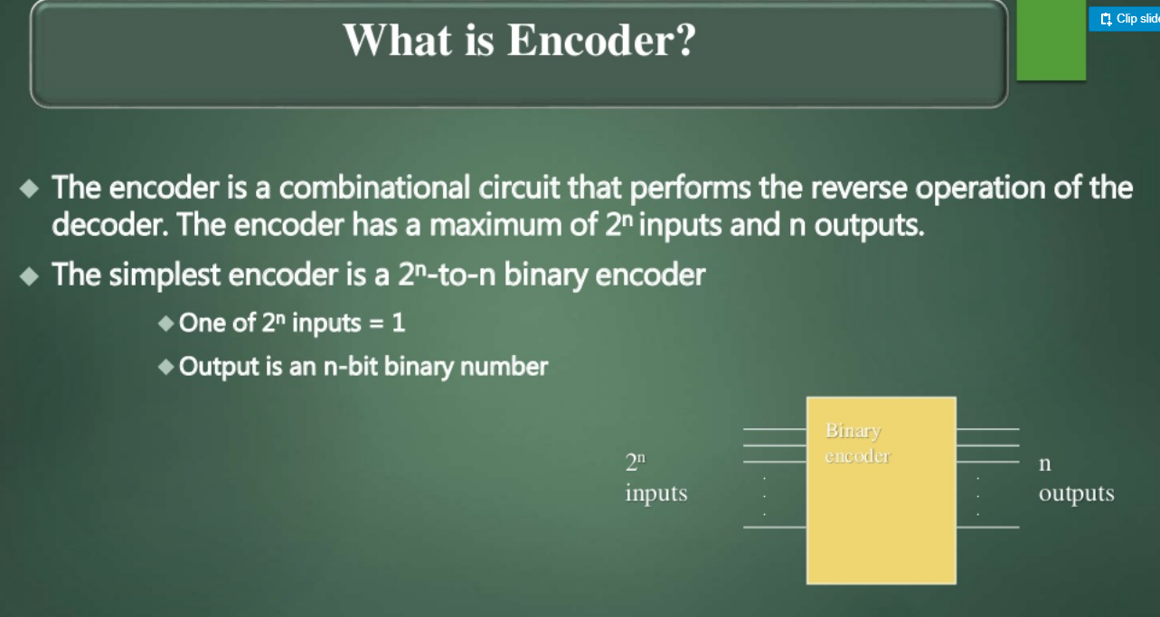

Slide 2
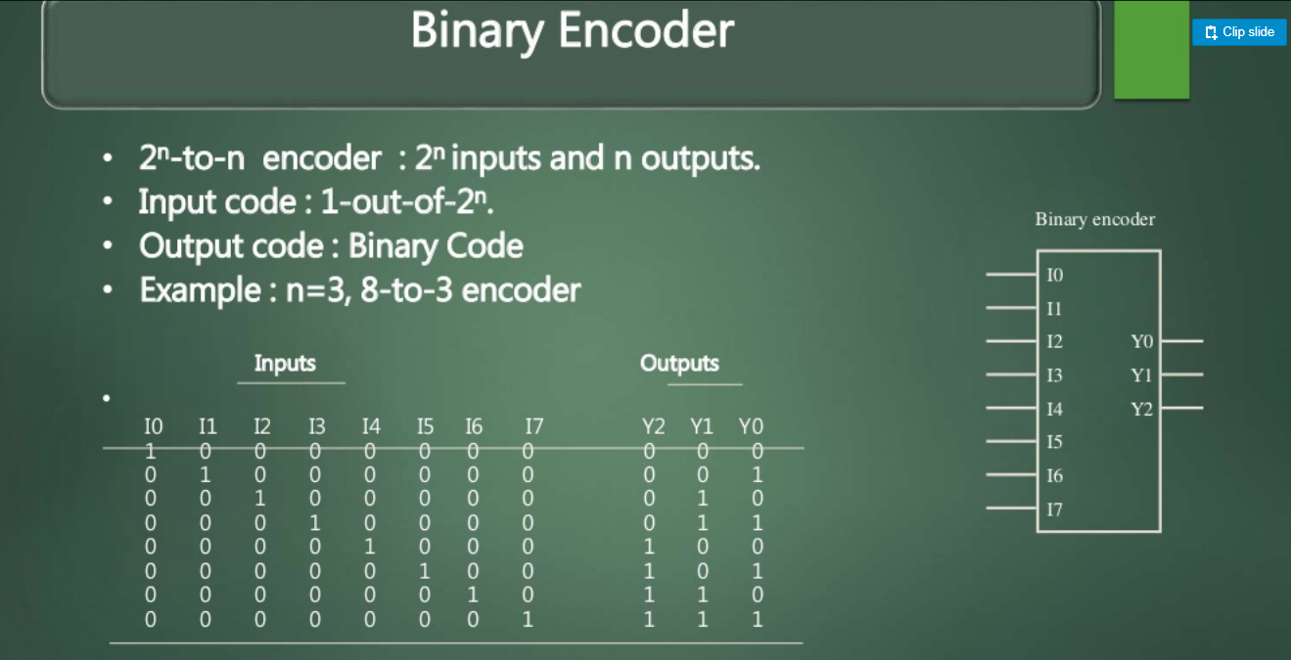

Slide 3
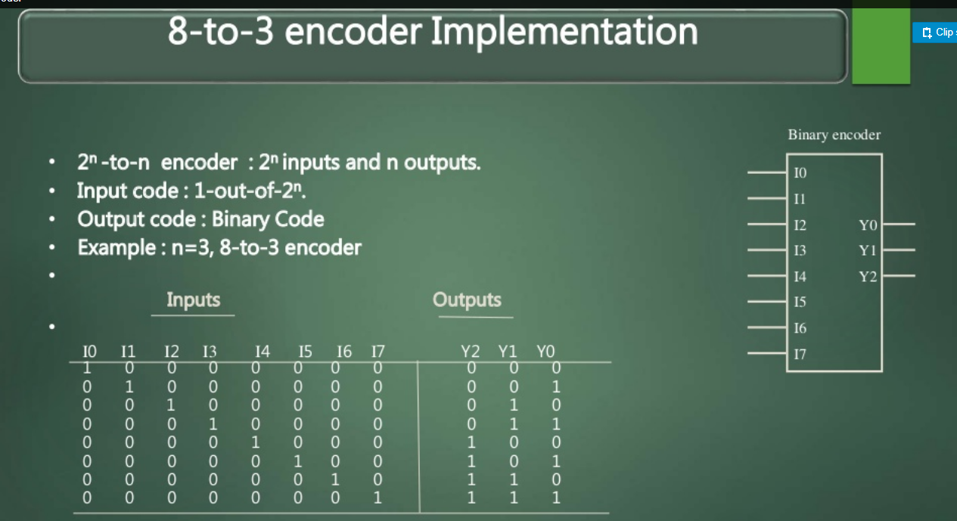

Slide 4
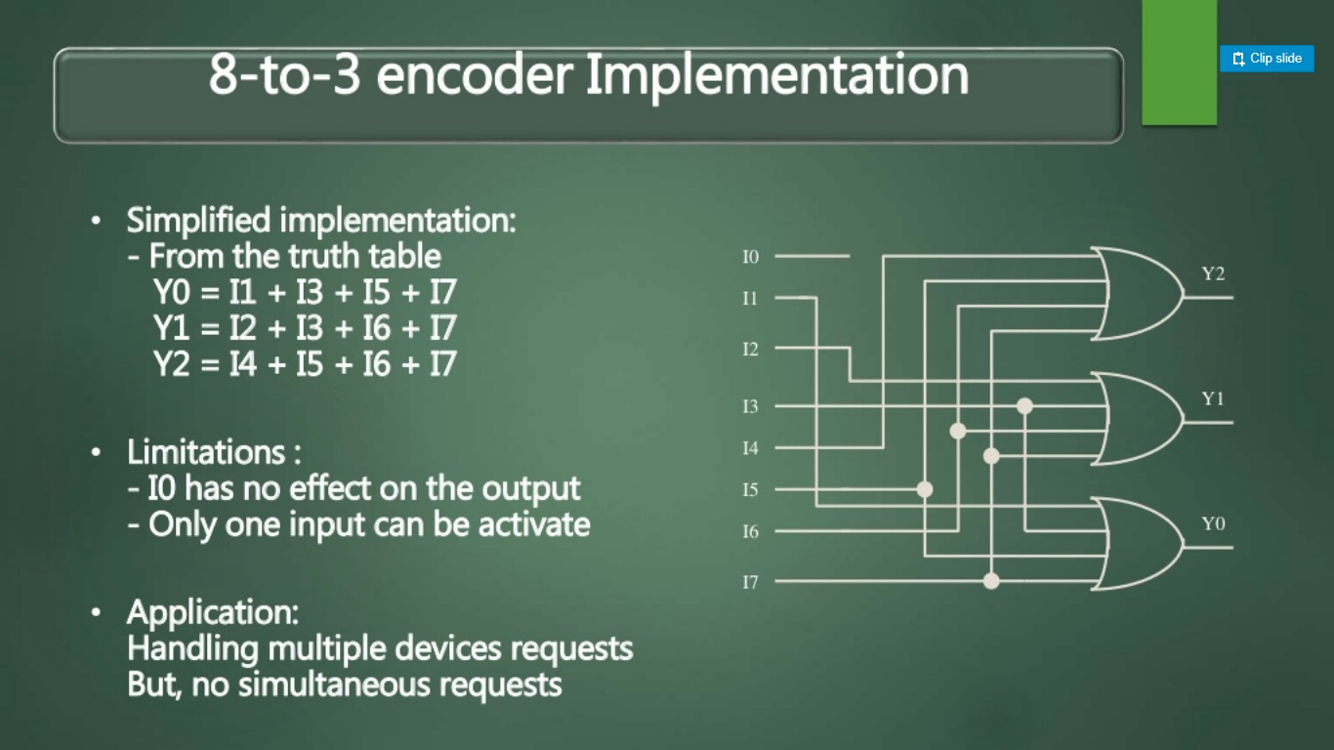

Slide 5
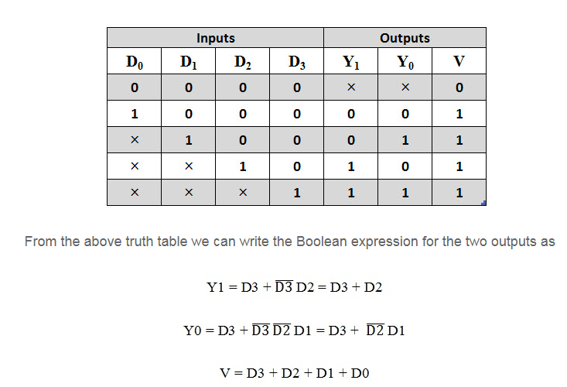
PRIORITY ENCODER

Slide 6
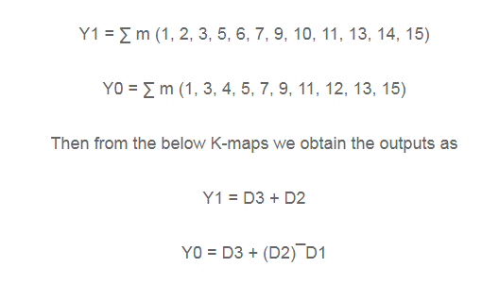

Slide 7
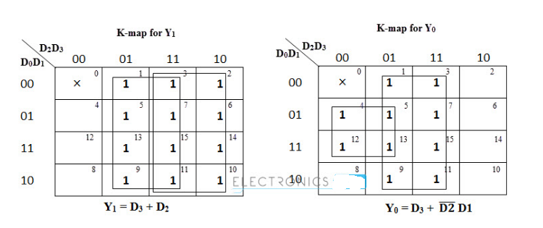

Slide 8
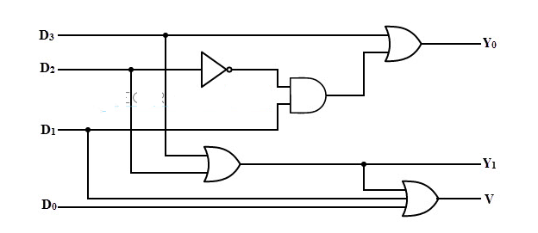

Slide 9
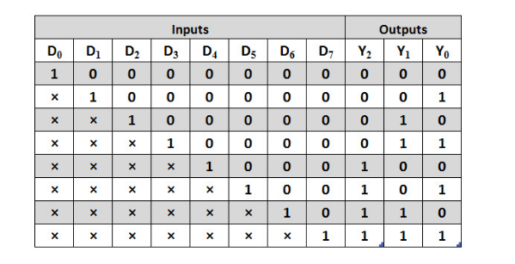

Slide 10
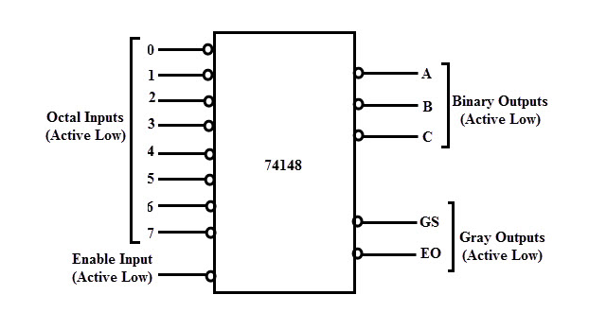

Slide 11
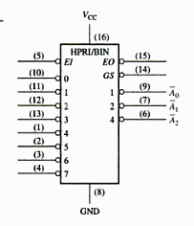

Slide 12
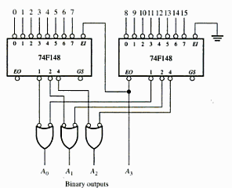

Slide 13
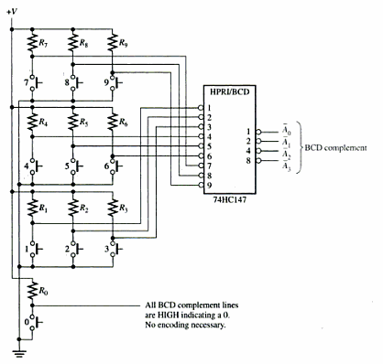

Slide 14
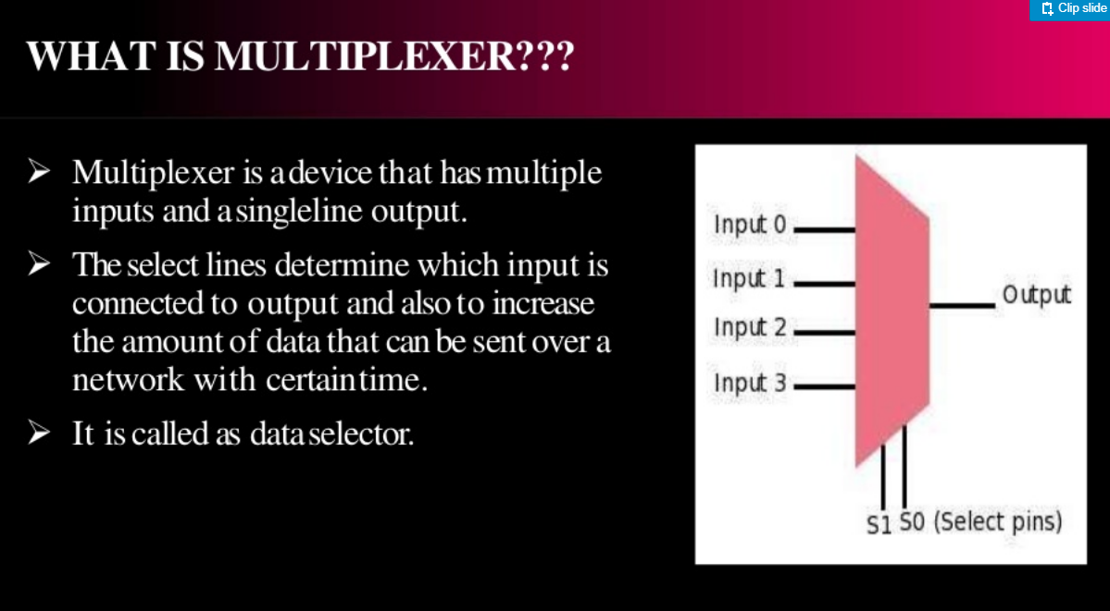

Slide 15
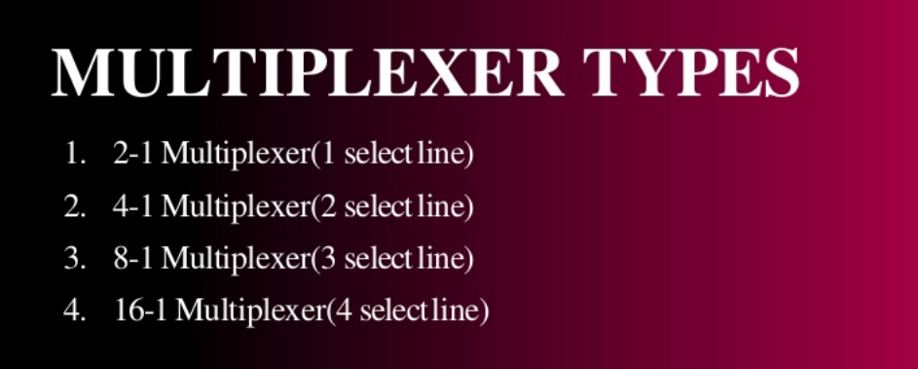

Slide 16
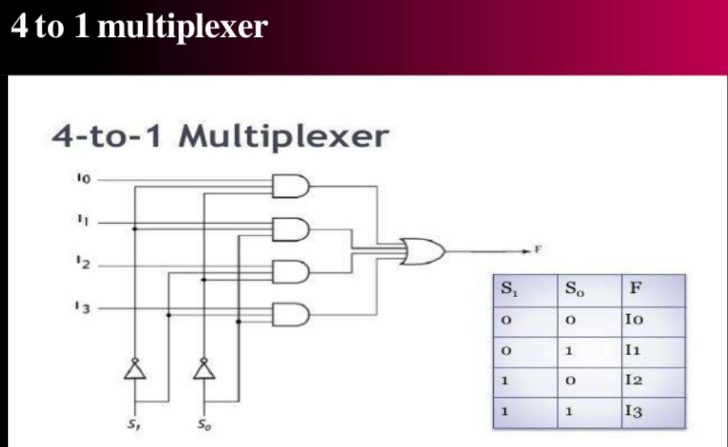

Slide 17
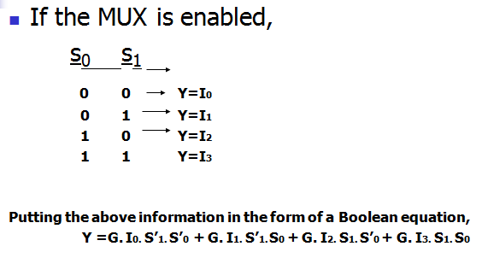

Slide 18
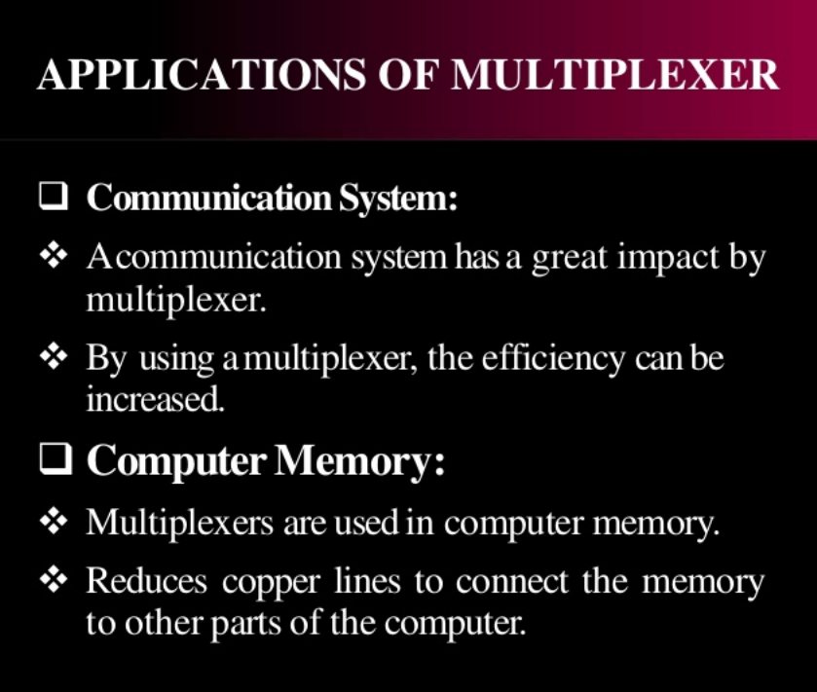

Slide 19
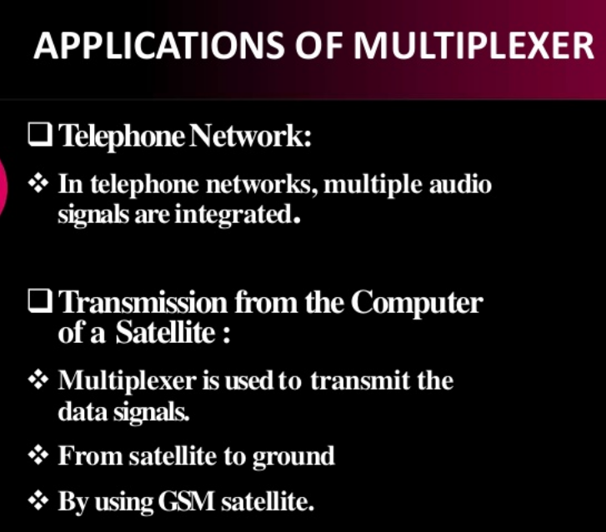

Slide 20
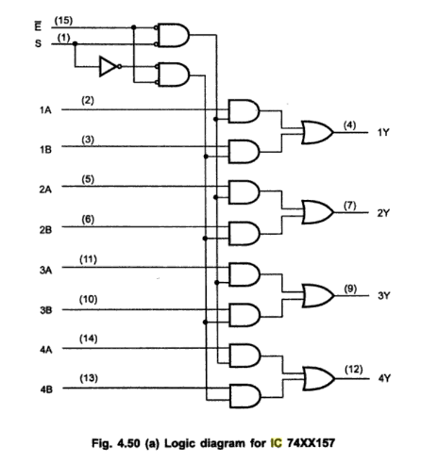

Slide 21
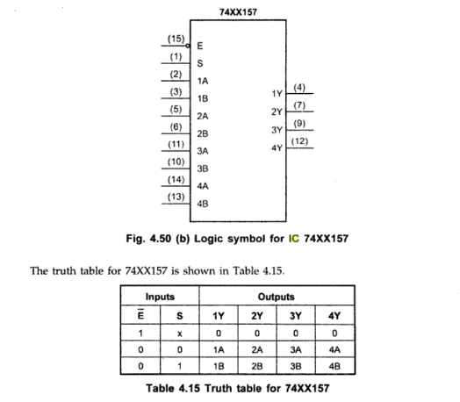

Slide 22
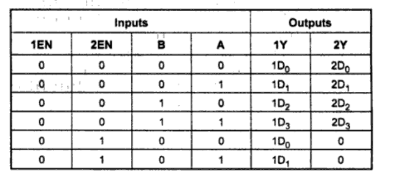
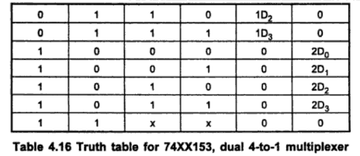

Slide 23
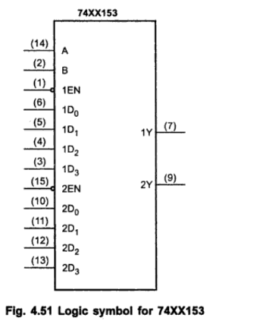

Slide 24
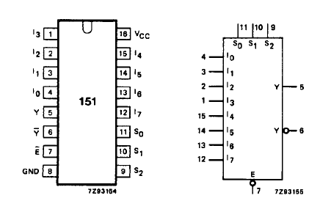

Slide 25
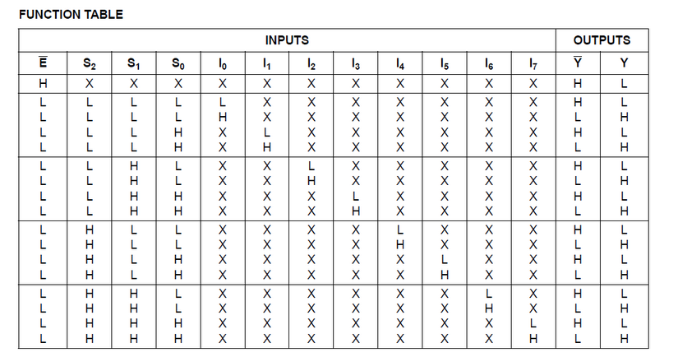

Slide 26
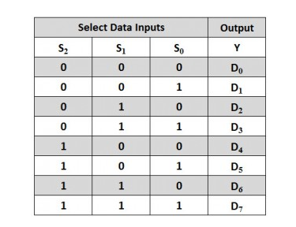

Slide 27
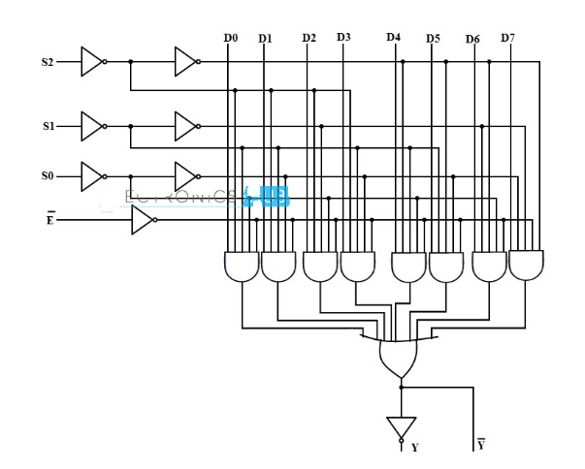

Slide 28
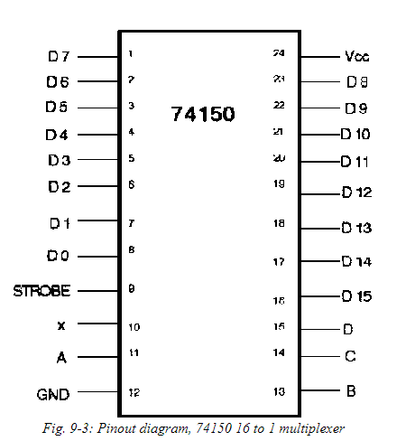

Slide 29
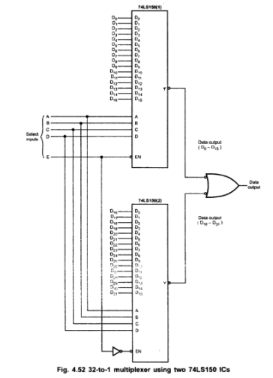

Slide 30
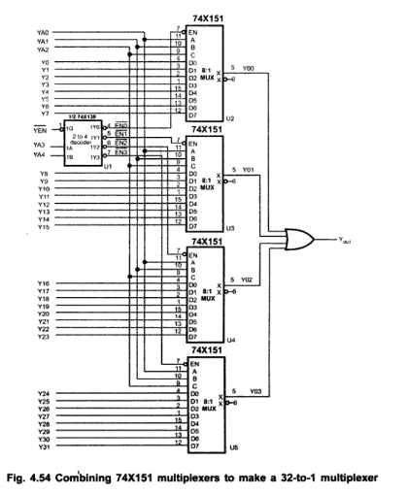

Slide 31
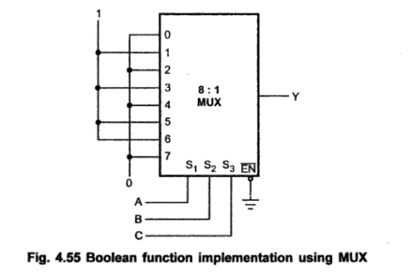

Slide 32
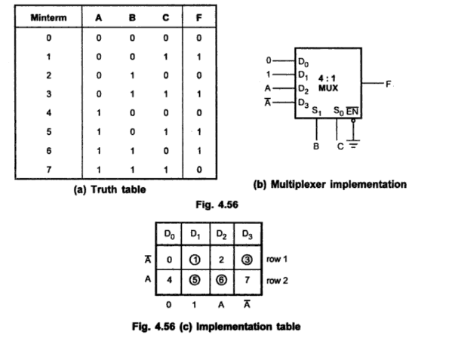

Slide 33
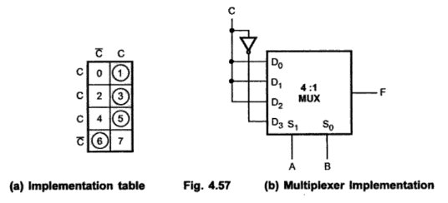

Slide 34
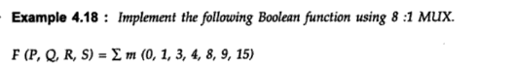
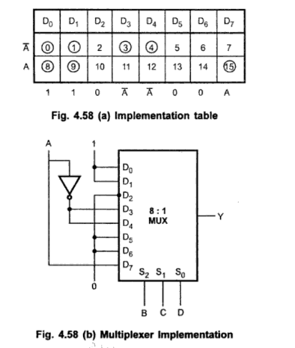

Slide 35
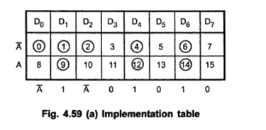

Slide 36
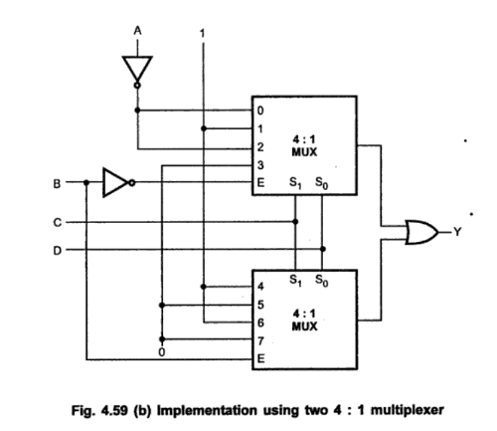

Slide 37
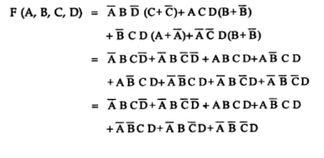

Slide 38
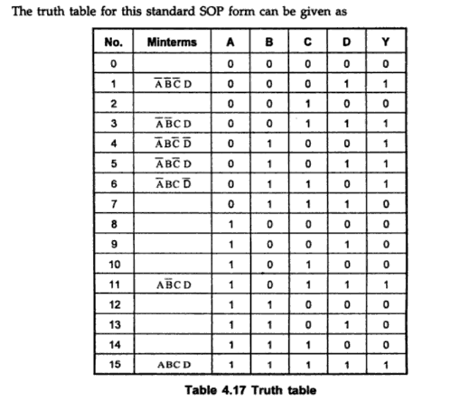

Slide 39
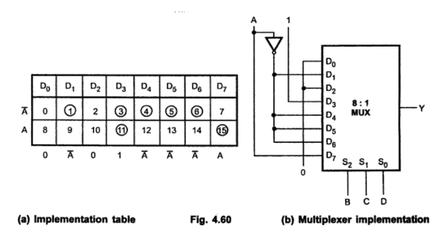

Slide 40
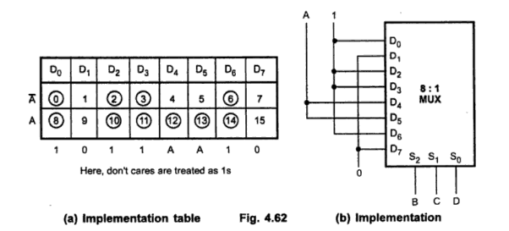

Slide 41
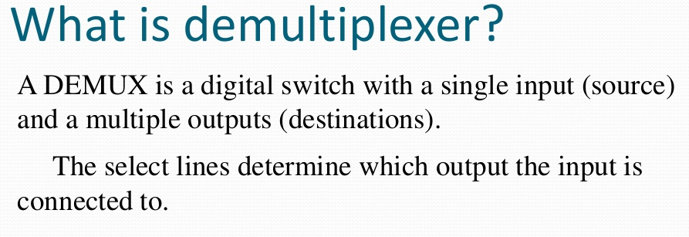

Slide 42
Demultiplexer
A demultiplexer is a device that takes a single input line and routes it to one of several digital outputlines. •
A demultiplexer of 2n outputs has n select lines, which are used to select which output line to send the input

Slide 43
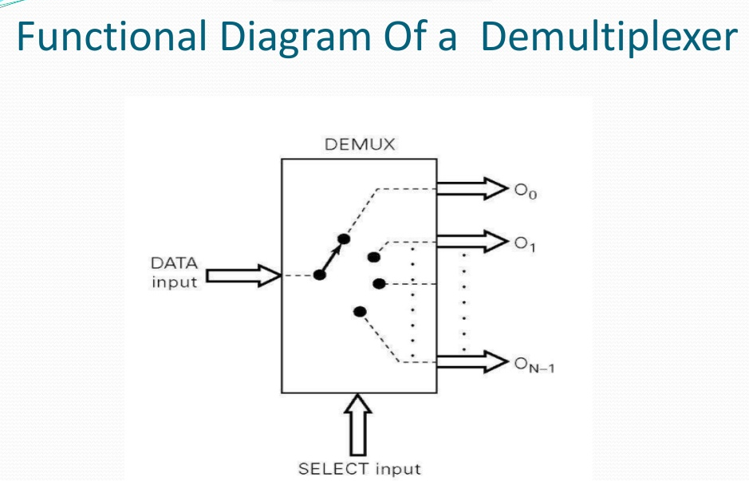

Slide 44
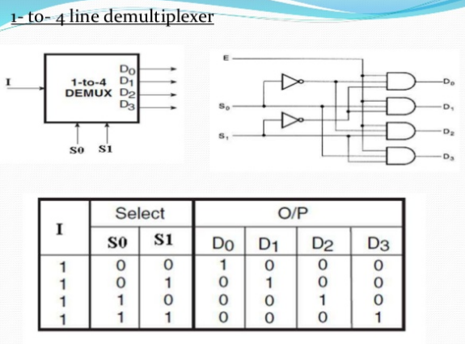

Slide 45
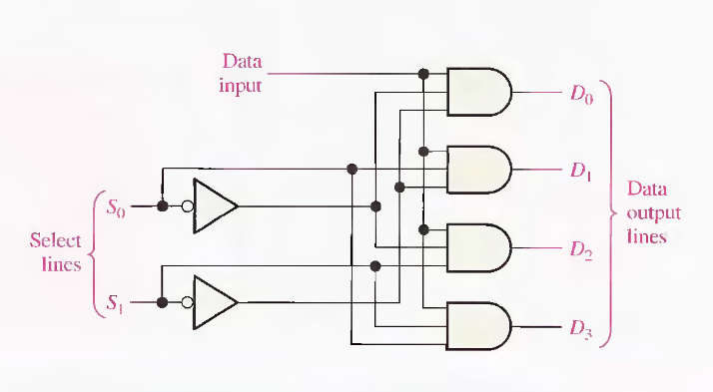

Slide 46
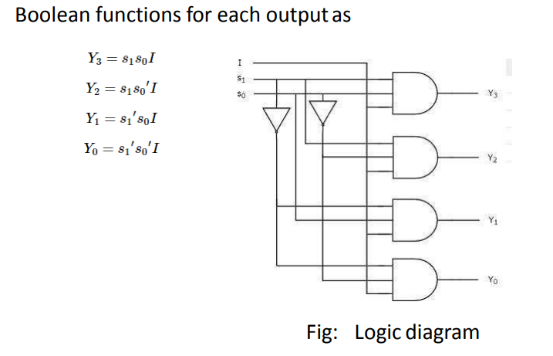

Slide 47
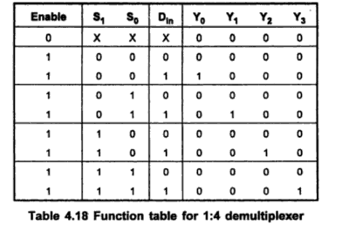

Slide 48
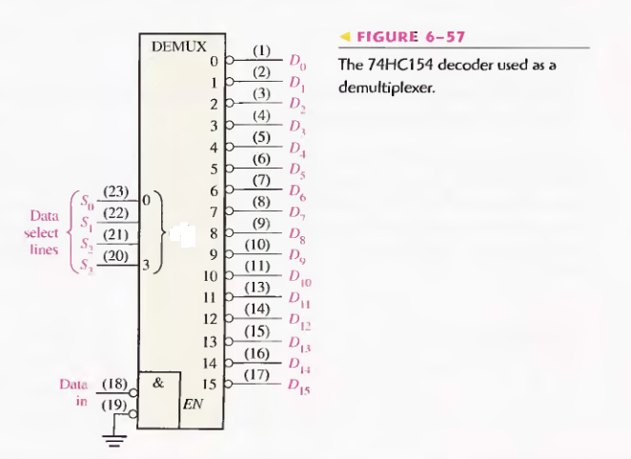

Slide 49
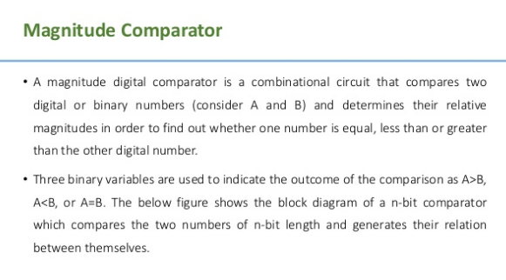

Slide 50


Slide 51


Slide 52


Slide 53


Slide 54


Slide 55


Slide 56


Slide 57


Slide 58


Slide 59


Slide 60


Slide 61


Slide 62


Slide 63
4-Bit Comparator
It can be used to compare two four-bit words.
The two 4-bit numbers are A = A3 A2 A1 A0 and B3 B2 B1 B0 where A3 and B3 are the most significant bits.
It compares each of these bits in one number with bits in that of other number and produces one of the following outputs as A = B, A < B and A>B.

Slide 64
4-Bit Comparator
The output logic statements of this converter are:
If A3 = 1 and B3 = 0, then A is greater than B (A>B). Or
If A3 and B3 are equal, and if A2 = 1 and B2 = 0, then A > B. Or
If A3 and B3 are equal & A2 and B2 are equal, and if A1 = 1, and B1 = 0, then A>B. Or
If A3 and B3 are equal, A2 and B2 are equal and A1 and B1 are equal, and if A0 = 1 and B0 = 0, then A > B.
The output A > B logic expression can be written as:

Slide 65

Then the logical expression for A=B output can be written as
E = (A3 Ex-NOR B3) (A2 Ex-NOR B2) (A1 Ex-NOR B1) (A0 Ex-NOR B0)

Slide 66


Slide 67


Slide 68


Slide 69


Slide 70
code converter
A code converter is a logic circuit whose inputs are bit patterns representing numbers (or character) in one code and whose outputs are the corresponding representation in a different code.

Slide 71


CODE CONVERTERS

Slide 72



Slide 73


Slide 74


Slide 75


Slide 76


Slide 77


Slide 78



Slide 79


Slide 80


Slide 81


Slide 82


Slide 83


